Slide 1
Full Stack Development At Blazethemes Pvt. Ltd.
By
Amir Maharjan

Slide 2
Table of content
Introduction
Introduction to Organization
Background study and literature review
Internship Activities
Conclusion and Learning Outcomes

Slide 3
Chapter 1: Introduction
tthimalaya.com is the official website of Touch The Himalaya Treks and Expedition.
The New Kit Elementor Addons plugin is a comprehensive toolkit designed to enhance the Elementor Page Builder

Slide 4
1.2 Problem Statement
Custom Theme Development
Custom Elementor Widgets
Performance and Responsiveness
Testing
Research

Slide 5
1.3 Objectives
To create a unique theme that aligns with the client's branding and functionality needs.
To develop custom Elementor widgets to enhance the plugin's features and facilitate content management.
To optimize the website for fast load times, mobile responsiveness, and compatibility with updates.

Slide 6
1.4 Scope and Limitation
Scope
development of custom Elementor widgets to enhance the plugin’s features
designing and implementing a fully custom WordPress theme
Limitation
certain advanced features or additional client requests had to be deprioritized for future updates
Some third-party plugins or external tools may have compatibility issues with the custom theme

Slide 7
Chapter 2: Introduction to Organization
Blazethemes Pvt. Ltd. is a leading web development company specializing in creating high quality WordPress themes and plugins.
Located in Tanglaphat (recently moved).
A small team

Slide 8
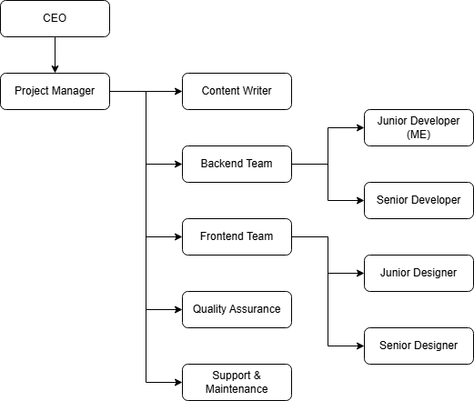
2.1 Organization Hierarchy

Slide 9
2.3 Working Domain of Organization
WordPress Theme Development
WordPress Plugin Development
Mobile App Development

Slide 10
2.4 Description of Intern Department/Unit
Start Date | November 5th, 2024
End Date | February 5th, 2025
Mentor | Mr. Dinesh Maharjan
Position | Intern
Duration | 12 Weeks
Working Hours | 8 hours
Working Days | 6 days a week

Slide 11
Chapter 3: Background study and literature review
In today’s digital world, WordPress has become the go-to platform for building websites, powering over 40% of the internet.
I worked with these technologies to enhance client websites, such as tthimalaya.com, and developed custom Elementor widgets for the News Kit Elementor Addons plugin
I faced challenges like balancing custom widget functionality with website performance and ensuring cross-device compatibility.
My internship provided valuable insight into how these technologies are applied in real-world projects to meet client demands for flexibility, performance, and visibility.

Slide 12
3.2 Literature Review
(Elementor, 2022) talks about what Elementor is, is it really a must-have tool or is it just smoke and mirrors? It explains about how to install Elementor, its competition, support, ecosystem, etc.
(Moghul, 2013) this paper explains what WordPress is, its architecture, technologies used and showcases the web portal they created using WordPress.

Slide 13
Chapter 4: Internship Activities
4.1 Roles and Responsibilities
Custom Theme Development
Elementor Widget Development
Quality Assurance and Testing
Collaboration and Communication

Slide 14
4.2 Weekly Log
Duration | Tasks / Activities
1st Week | Learn the basics of JavaScript & PHP.
2nd Week | Admin login, registration form, CURD Operations
3rd Week | Mini project: Gallery Management System
4th Week | Mini project: Tic Tac Toe Game
5th Week | Install WordPress, Template Hierarchy, Theme Handbook
6th Week | URL Anatomy, Create homepage, archive, single for client site
7th Week | Plugin Handbook, use ACF plugin, WordPress Customizer, add options in customizer
8th Week | Quality Assurance, test client site, study WordPress block themes
9th Week | Study Elementor page builder, its editor, editor controls, hooks, styles, create mailbox, phone call widget.
10th Week | Study competition and their features, study market trends, popular themes and plugins, create few custom widgets
11th Week | Create 3 news-carousel, 4 news-filter widgets, RND
12th Week | Learn licensing, JS frameworks and libraries, RND

Slide 15
4.3 Description of the projects involved during internship
Project 1: Website Development – tthimalaya.com
Project 2: Custom Elementor Widgets - New Kit Elementor Addons

Slide 16
4.4 Tasks / Activities Performed
Add Slick Slider
Adding custom options in customizer
Adding Post meta
News Timeline Widget

Slide 17
Chapter 5: Conclusion and Learning Outcomes
The internship at Blazethemes Pvt. Ltd. provided an invaluable opportunity to gain real-world experience in WordPress development, Elementor customization, and modern web design practices
I was able to work in development in of a client site (tthimalaya.com) and create custom elementor widgets for company propriety plugin News Kit Elementor Addons

Slide 18
5.2 Learning Outcomes
Gained practical experience in WordPress and Elementor development
Enhanced problem-solving, time management, and collaboration skills
Gained insight into plugin development and real-world project workflows

Slide 19
Thank you

